Slide 1
QSCOUT
Jaqal

Slide 2
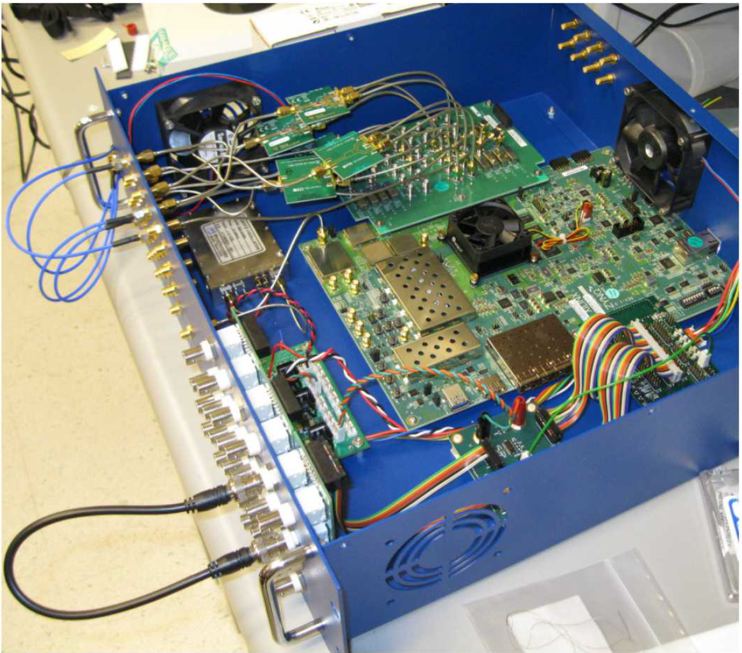
Sandia RFSoC System

Slide 3
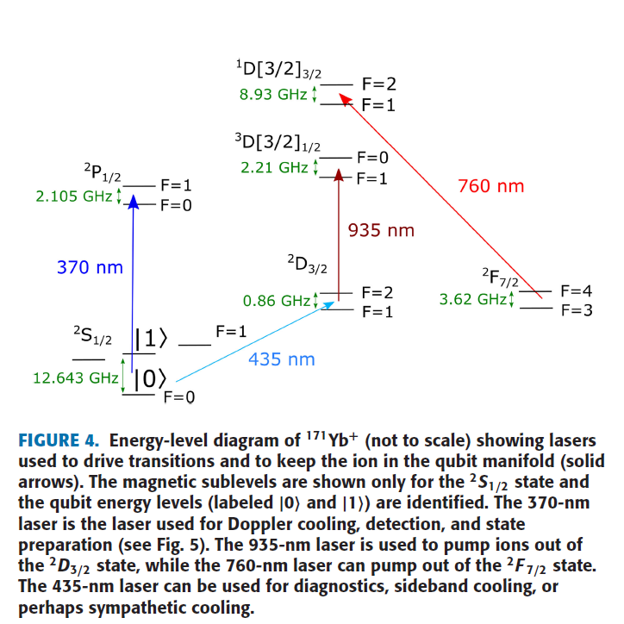
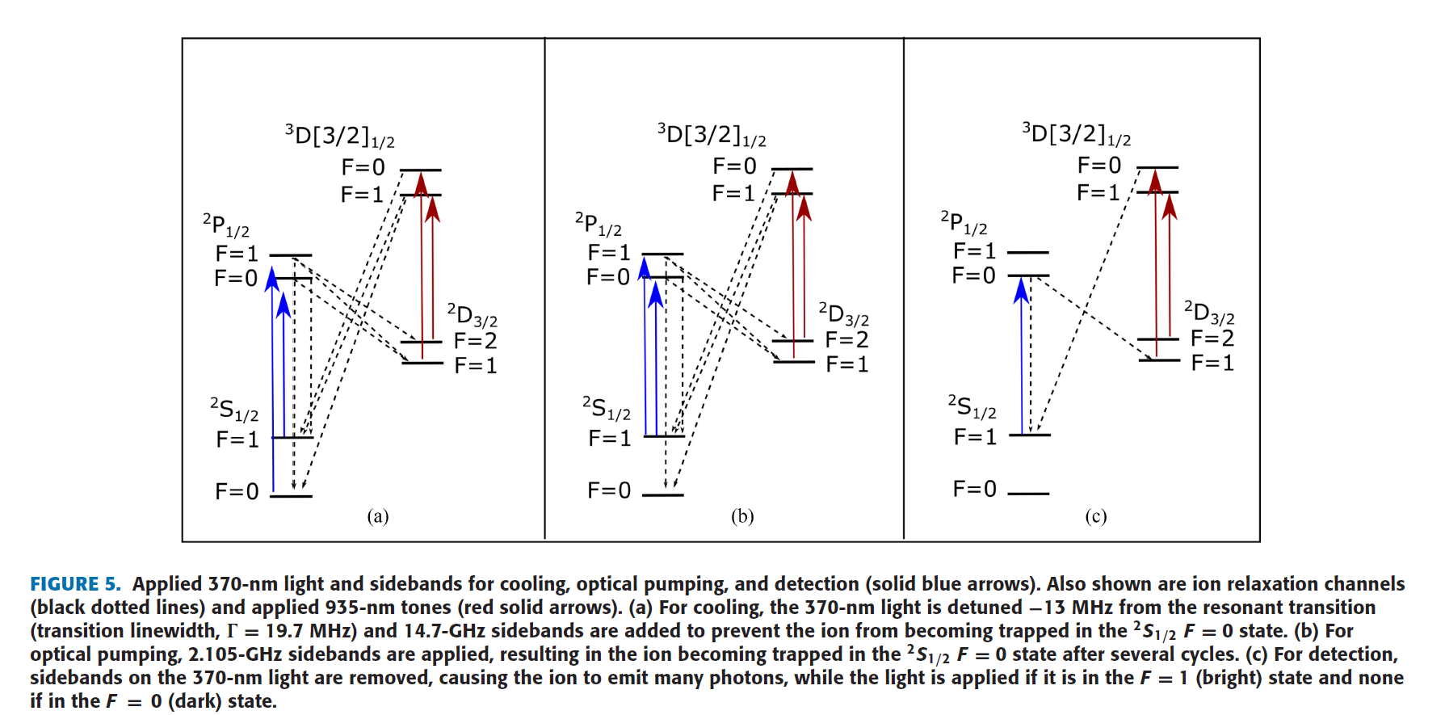
171Yb Energy Diagram

Slide 4
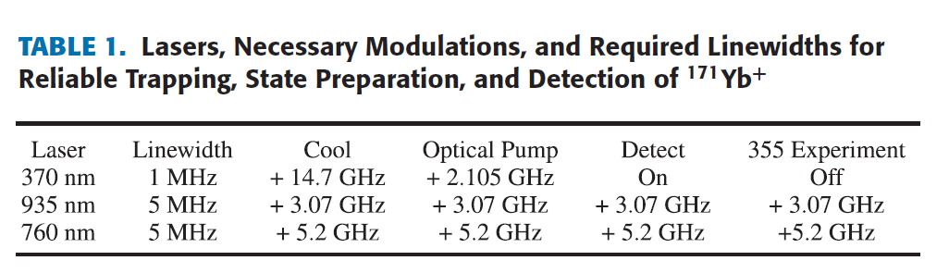
Laser frequency detuning

Slide 5
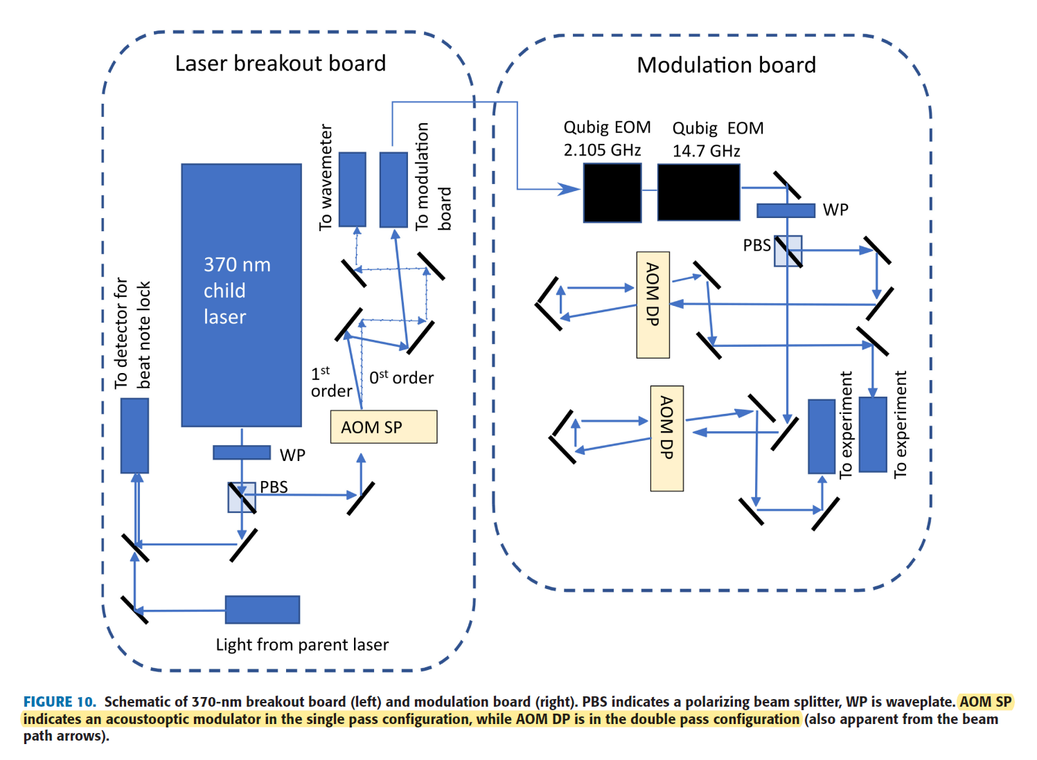
369nm setting

Slide 6
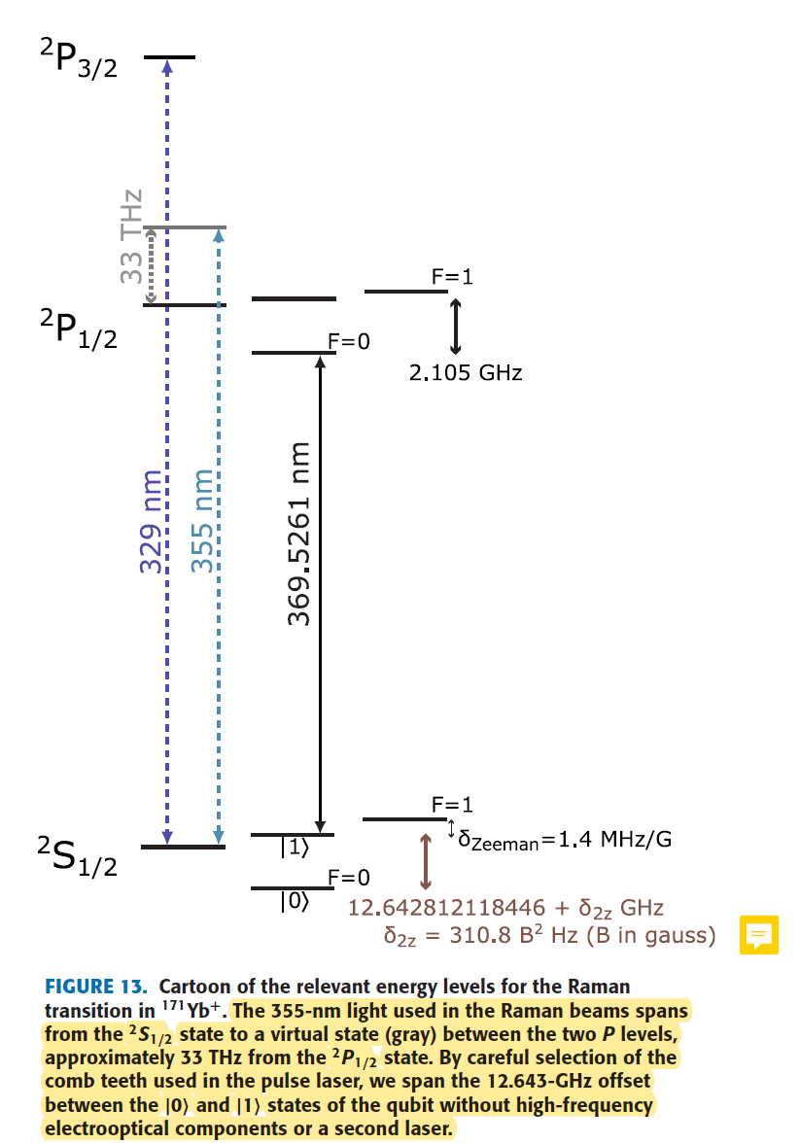
Qubit Manipulation
Two qubit gate : 12.64GHz -> can be drived by microwave
However, laser is ...
1. Tight focusing
2. Individual addressing
3. Two qubit gates mediated by phonon bus(e.g. MS gate)

Slide 7
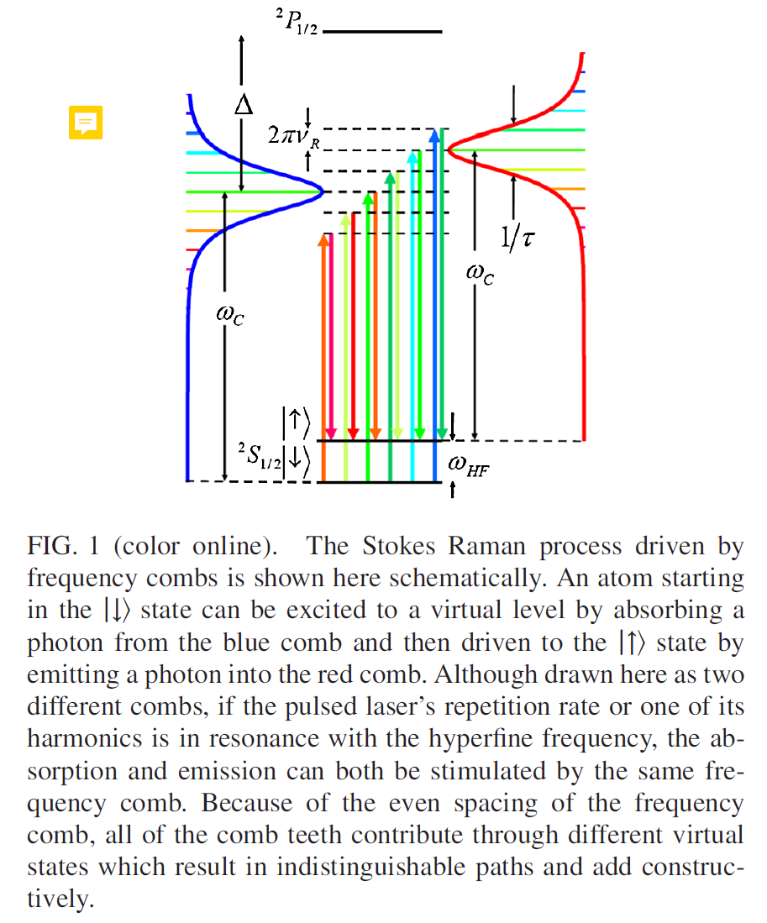
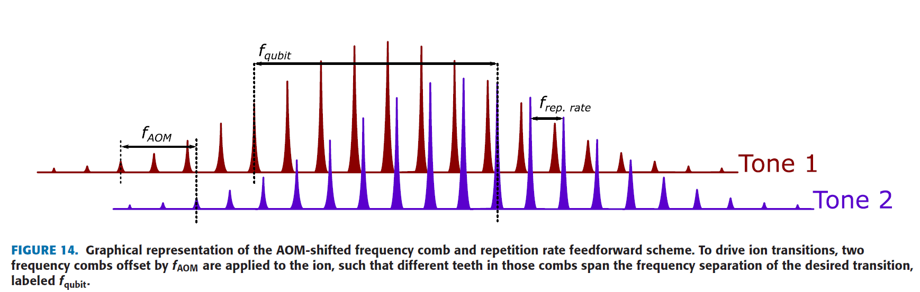
Frequency Comb

Slide 8
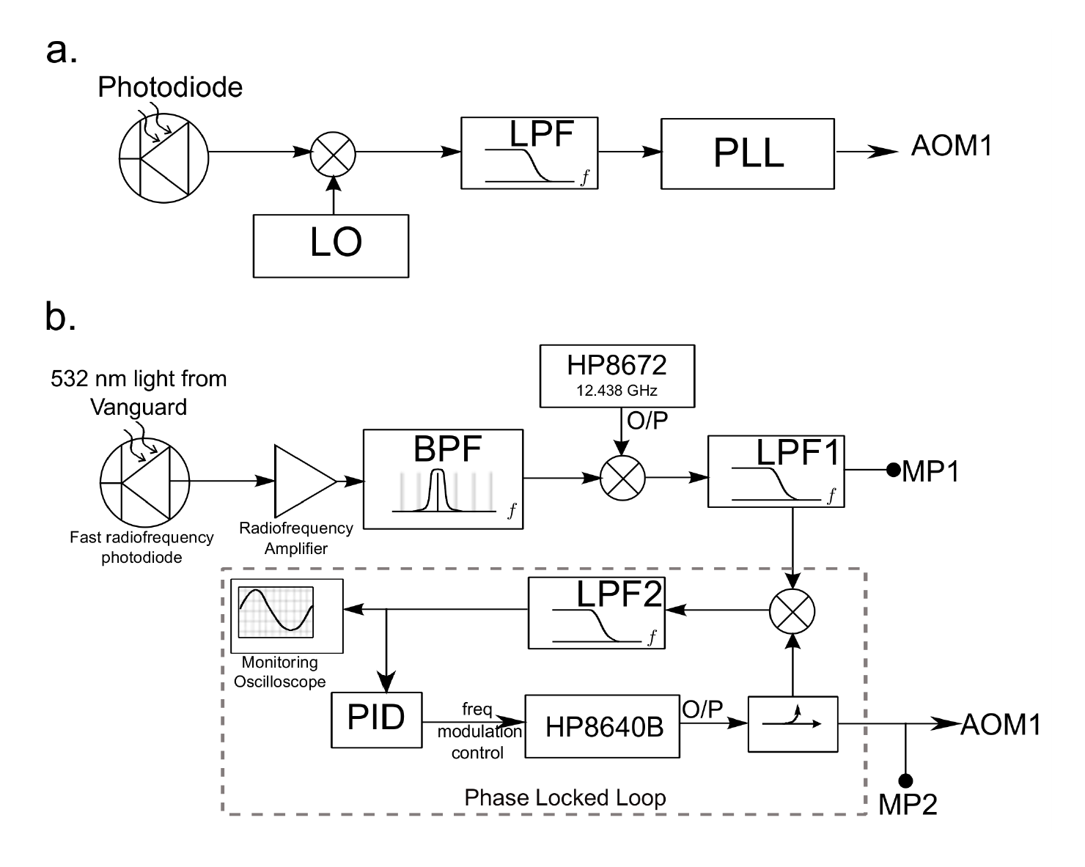
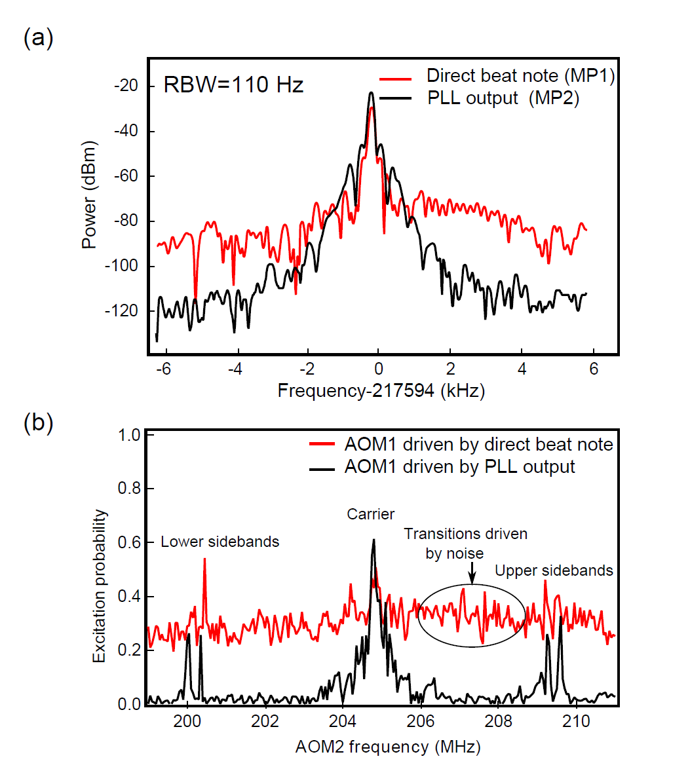
Frequency Comb Implementation

Slide 9
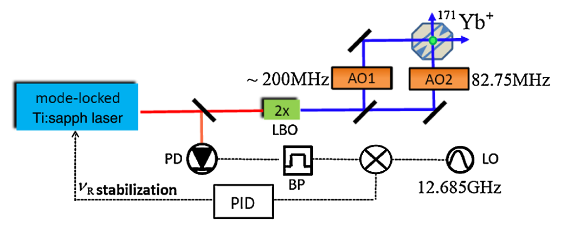
Frequency Comb Implementation(2)

Slide 10
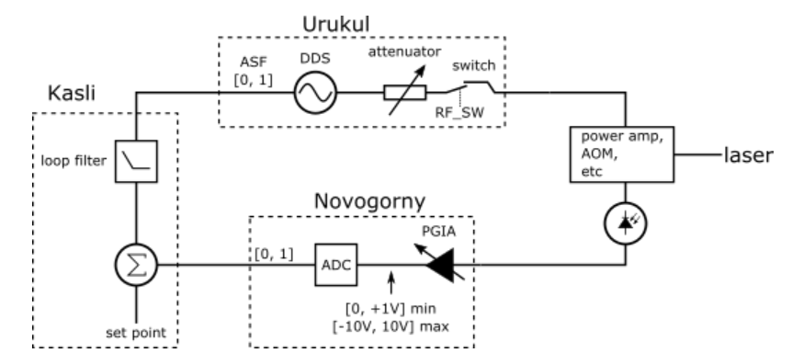
Artiq Urukul Servo
PID control is implemented in PL(FPGA) side

